Slide 1
Disclaimer
These slides are intended as presentation aids for the lecture. They contain information that would otherwise be to difficult or time-consuming to reproduce on the board. But they are incomplete, not self-explanatory, and are not always used in the order they appear in this presentation. As a result, these slides should not be used as a script for this course. I recommend you take notes during class, maybe on the slides themselves. It has been shown that taking notes improves learning success.

Slide 2
Reading for this set of slides
Craig – Intro to Robotics (3rd Edition)
Chapter 10.8
Please note that this set of slides is intended as support for the lecture, not as a
stand-alone script. If you want to study for this course, please use these slides
in conjunction with the indicated chapters in the text books. The textbooks are
available online or in the TUB library (many copies that can be checked out for the entire semester. There are also some aspects of the lectures that will not be
covered in the text books but can still be part of the homework or exam. For those
It is important that you attend class or ask somebody about what was covered in class.

Slide 3
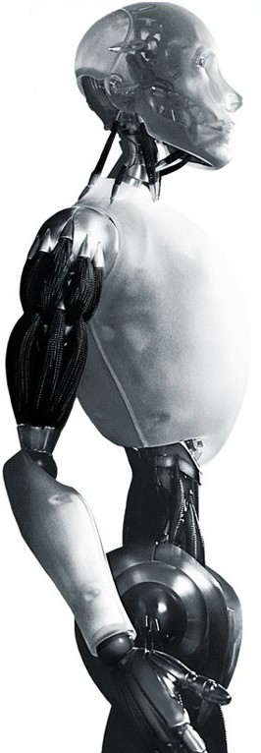
Robotics First Steps in Operational Space Control
TU Berlin
Oliver Brock
TexPoint fonts used in EMF.
Read the TexPoint manual before you delete this box.: AAAAAA

Slide 4
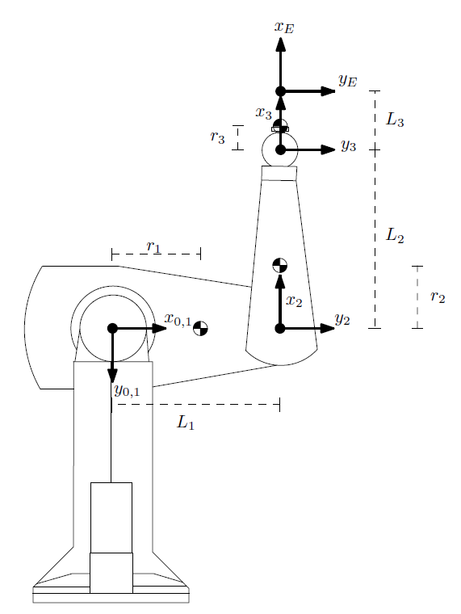
Following a Trajectory With the End-Effector
des
des
See Tutorial on Trajectory Generation

Slide 5
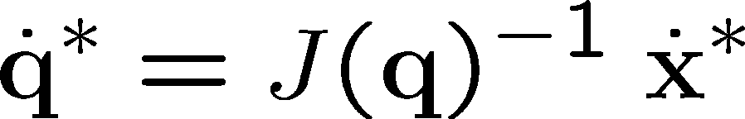
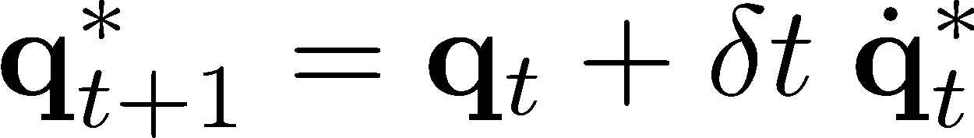
Resolved-Rate Motion Control
The * indicates a desired quantity as opposed to a measured one

Slide 6

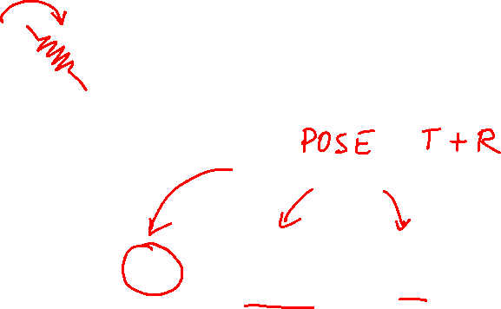
Control of the End-Effector
des
des

Slide 7

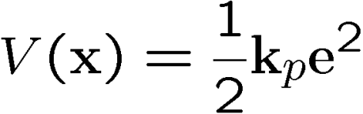
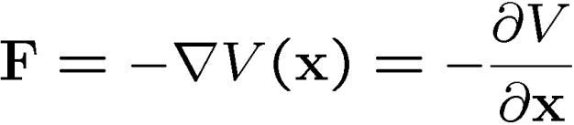



P Control in Operational Space
Idea: apply force proportional to error
position gain
V(x)
x

Slide 8
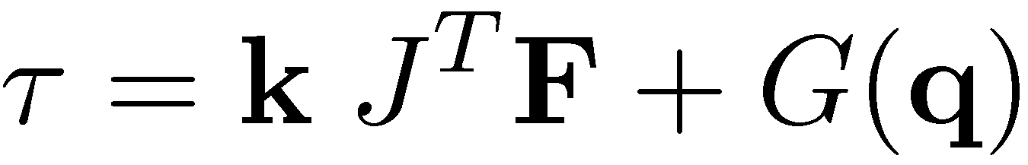
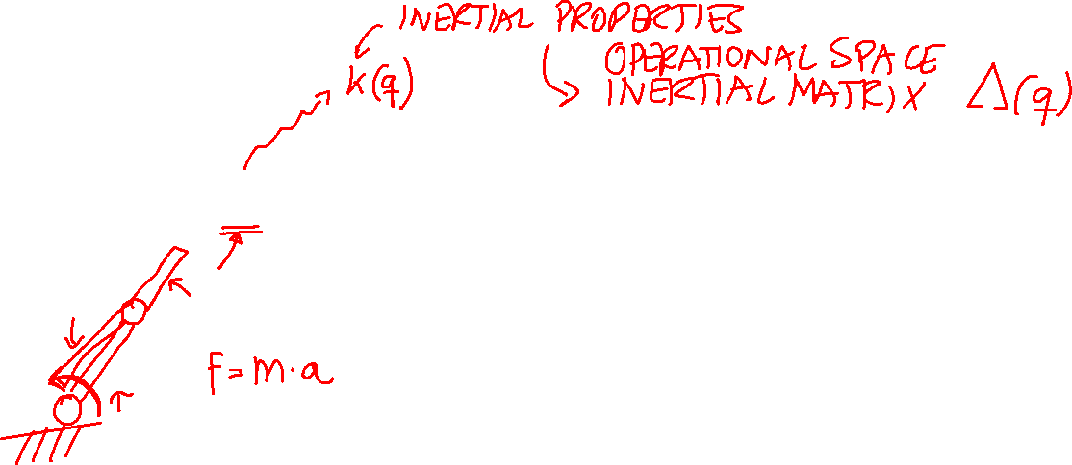
First Operational Space Control

Slide 9

Notes:
Illustrate what happens when a 2DOF rotational robot arm loses 1 DOF
Background image
https://www.pexels.com/photo/background-black-blackboard-board-159770/

